Slide 1
Title : Flash Upgrade, Sigma Studio Plus
24 Oct 2024

Slide 2
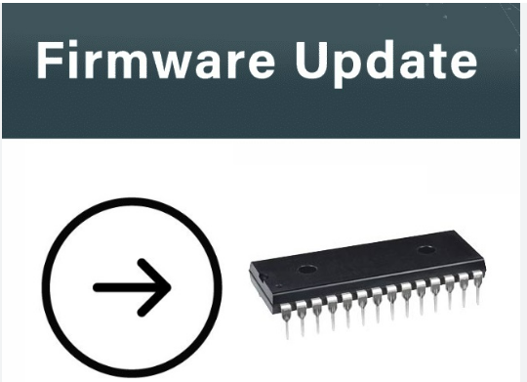
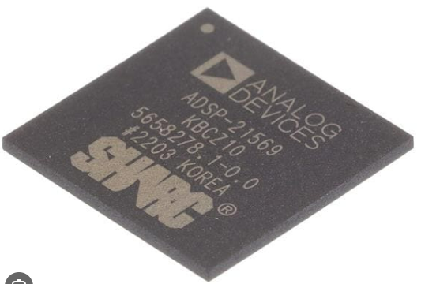
Firmware update and Purposes
A firmware update is the process of upgrading the firmware installed on a device by altering its code. Firmware updates typically come from the device manufacturer and are designed to fix bugs, improve performance, enhance security and introduce new features.
How to update firmware depends on the device, and updates can be delivered through various channels,
Over-The-Air (OTA) through wi-fi/ Bluetooth.
USB connections using USB storage devices.
through computer software provided by the manufacturer.

Slide 3
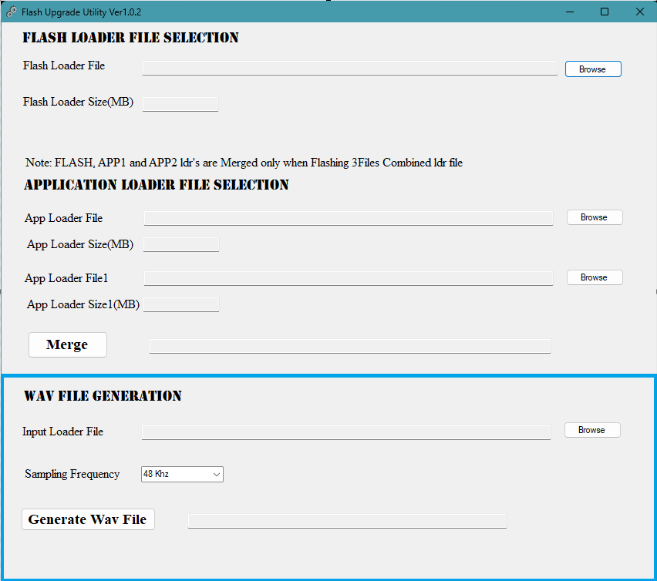
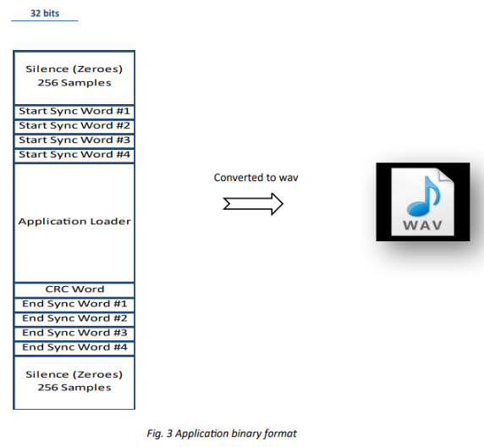
Firmware update via HDMI
Audio applications such as AVR and Soundbar use flash devices where the audio processing modules binary image is stored. This binary image is loaded into the DSP during the booting process and executes from DSP in run time.
This .wav file will be played back through HDMI using any audio pumping device and the DSP will be configured (Command A) to take the Audio application loader content and write into the Flash memory space.

Slide 4
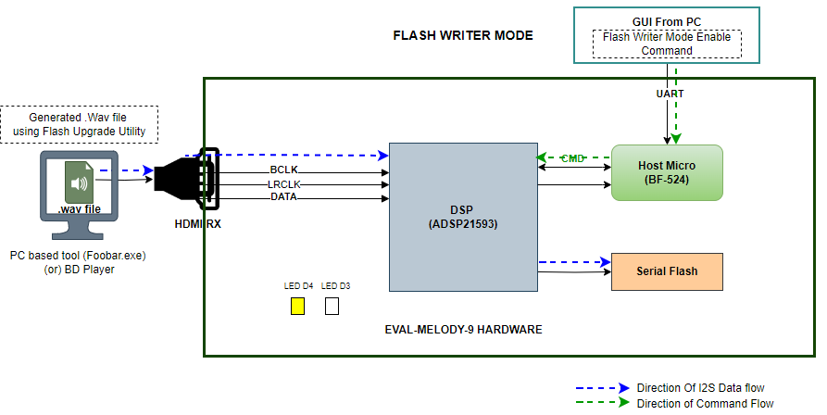
Flash Writer Mode – Before Flashing

Slide 5

Flash Writer Mode – After Flashing

Slide 6
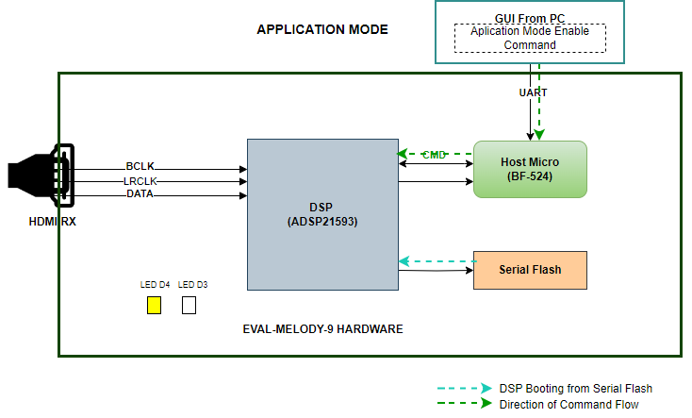
Application Mode

Slide 7
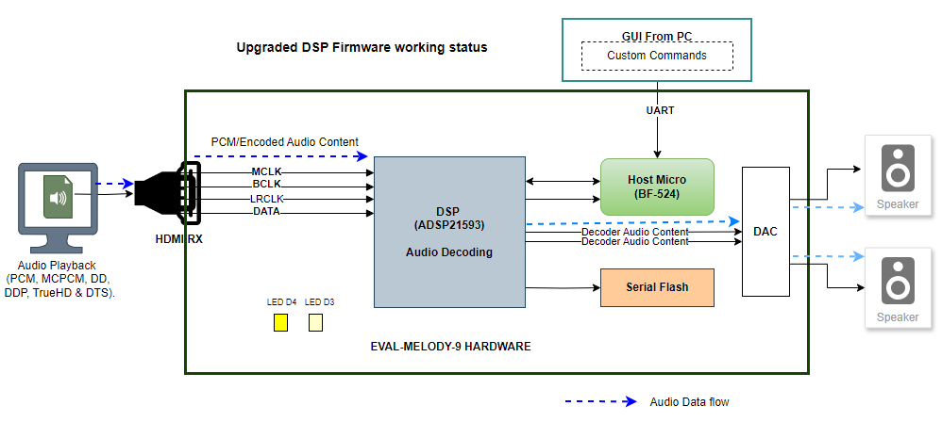
Upgraded DSP Firmware working status

Slide 8
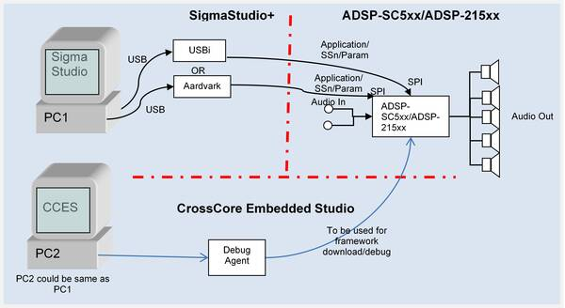
Sigma Studio Plus
The SigmaStudio®+ graphical development tool is the programming, development, and tuning software for the SHARC® audio processors
SigmaStudio Plus includes an extensive library of algorithms to perform audio processing such as filtering, mixing, and dynamics processing, as well as basic low-level DSP functions and control blocks. Plug-in algorithms from Analog Devices and 3rd party partners can be added to SigmaStudio's drag-and-drop library

Slide 9


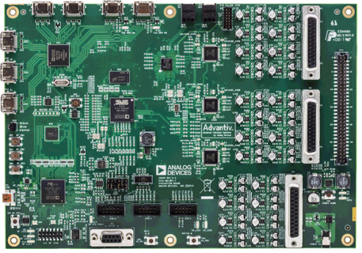
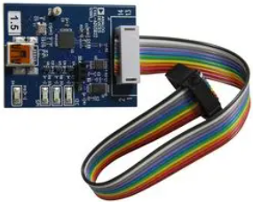
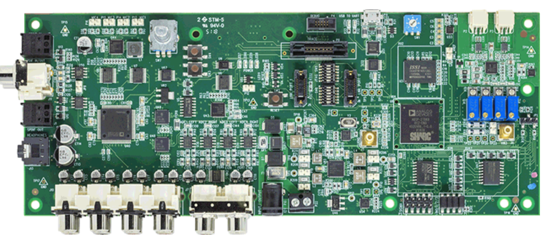
Software and Hardware Requirement
Software Required:
Cross Core Embedded Studio [CCES v2.9.1 or Later]
SigmaStudio+ [2.1.0 or Later]
Hardware Required:
ADSP-21569 EZ BOARD
Eval Melody-8 (ADSP-21569)
EVAL-ADUSB2EBUZ (USBi)

Slide 10
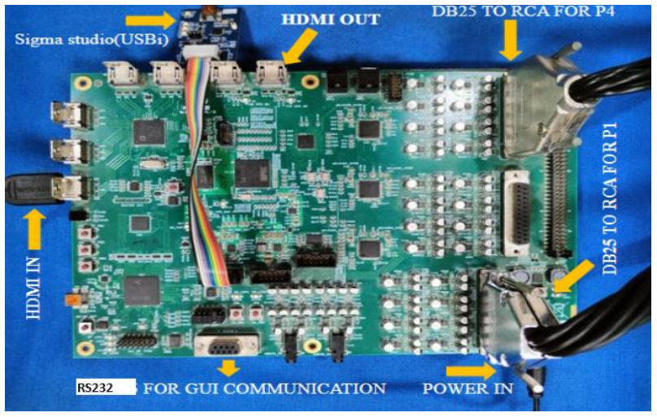
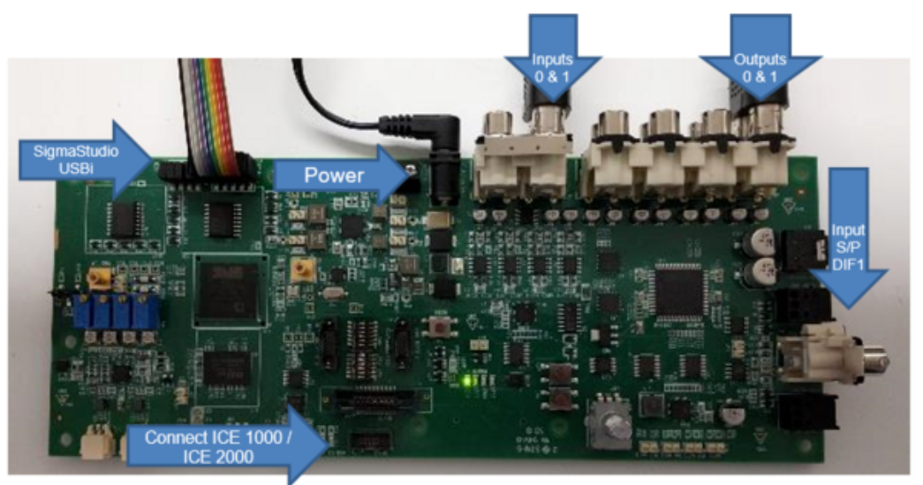
Hardware Connections
ADSP-21569-EZ-KIT

Slide 11
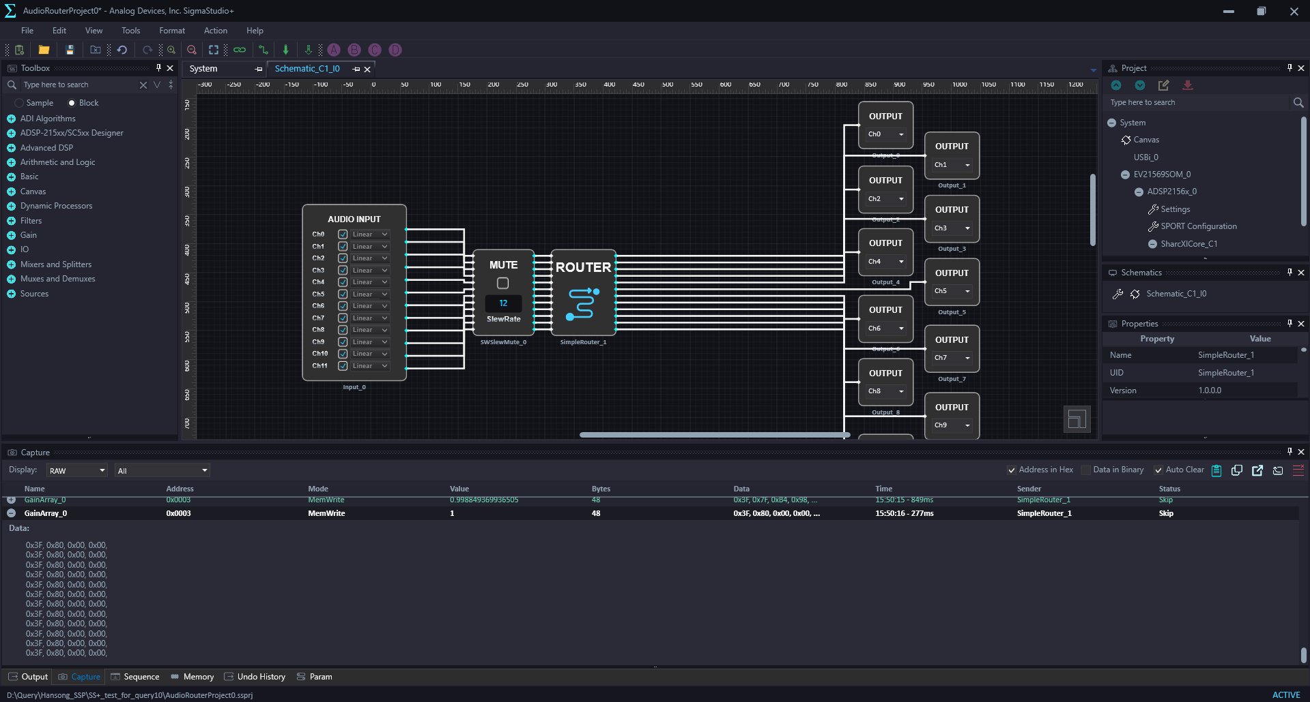
SS+ Graphical Development Environment

Slide 12
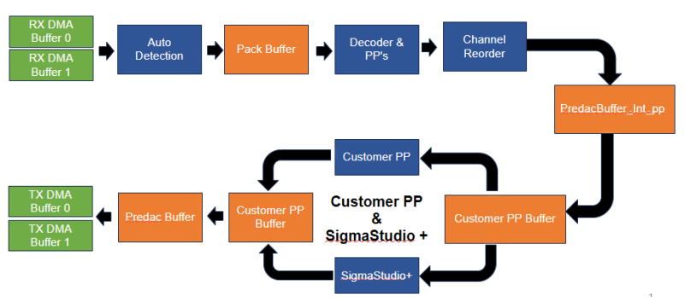
Sigma Studio Plus on Jasmin GUL SDK

Slide 13
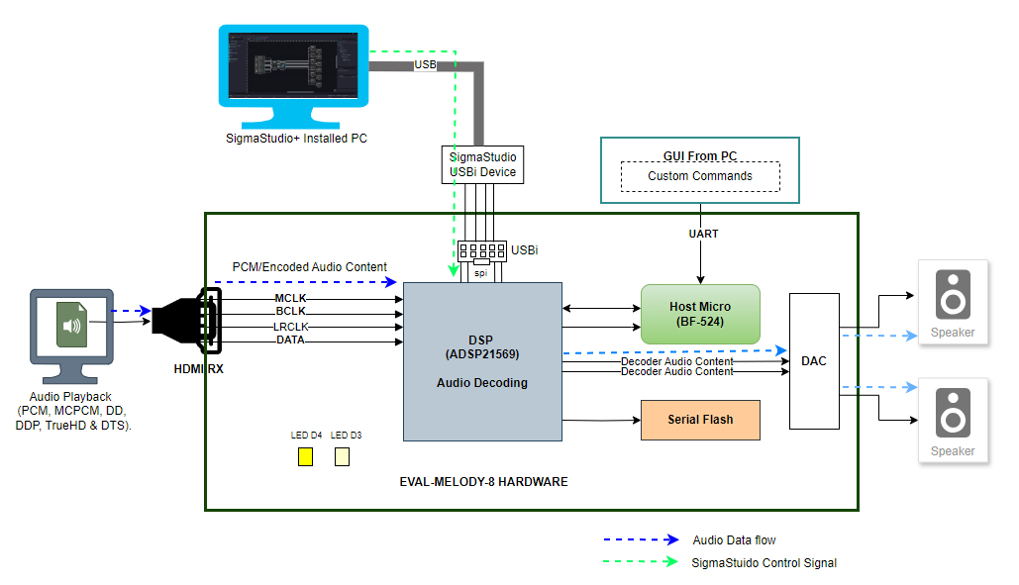
Sigma Studio+ Design Mode

Slide 14
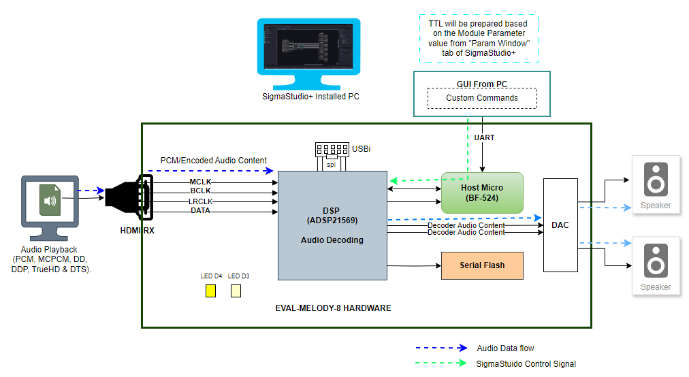
Sigma Studio+ Deployment Mode

Slide 15
References
SigmaStudio+ [Analog Devices Wiki]
ADZS-21569-EZKIT Evaluation Board | Analog Devices
EVAL-MELODY-8 Evaluation Board | Analog Devices
SHARC Processors Software and Tools | Analog Devices
https://youtu.be/DX8qS3dbtmE?si=g4DUcTda0zJW6Gp9

Slide 16
Task and Activity
Prepare SigmaStudio+ Schematics with the following feature.
8 channel input
2 channel output (8 channels are mixed to create stereo effect).
Include mute option for each channel.
Include eight band equalizer to control the effect of stereo output channels (Band Freq : 200Hz, 2KHz, 5KHz, 8KHz, 10KHz, 12KHz, 14KHz & 16KHz).
Include White noise and route the noise signal into 2 channel output if required, using switchable option between noise and audio signal.
How does Flash Upgrade work?, based on your understanding list down step-by-step procedure with your own words.

Slide 17






India, Germany, Japan, USA & China
+91 44 6666 9600
www.jasmin-infotech.com
THANK YOU!

